Slide 1


Computational Intelligence (TC2027)

Slide 2

Unit 2 – Network Review
Goals
Numbers System
Review of Network Architectures
OSI & TCP/ Reference Model
IP Protocol
ARP / RARP
ICMP

Slide 3


Attention!!!!
It is not an introduction course; it is a review course.
It is expected that students have background in the networking and operational system.

Slide 4
Numbers System

Slide 5

Data Representation
Humans use decimal (base 10) numbers to represent numeric information, and various alphabets and symbol systems to represent other types of information.
In contrast, computers understand only one basic type of information: ones and zeroes, which themselves are representative of either an “on” or “off” electrical or light state within the hardware of the device.
For this reason, larger collections of bits have been defined by computer scientists, such as bytes (octets), words, and so forth.

Slide 6
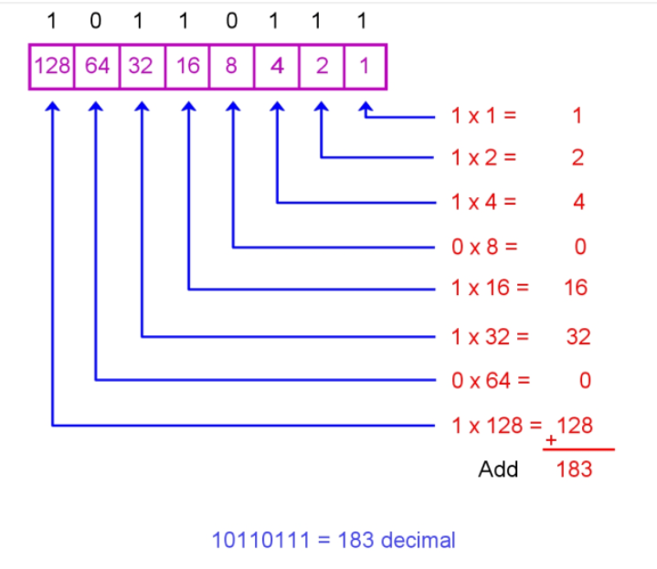
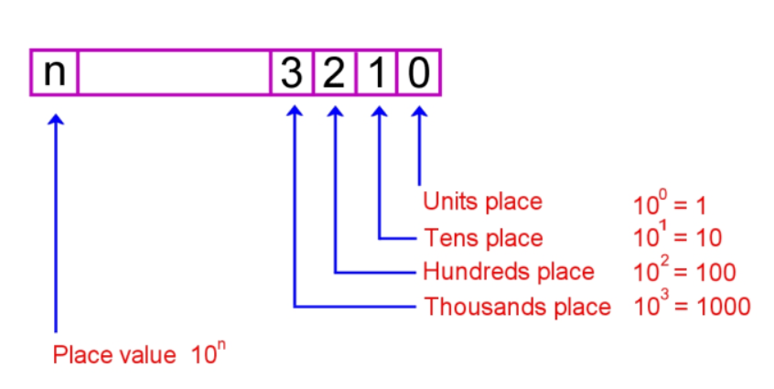
Binary to Decimal Conversion

Slide 7
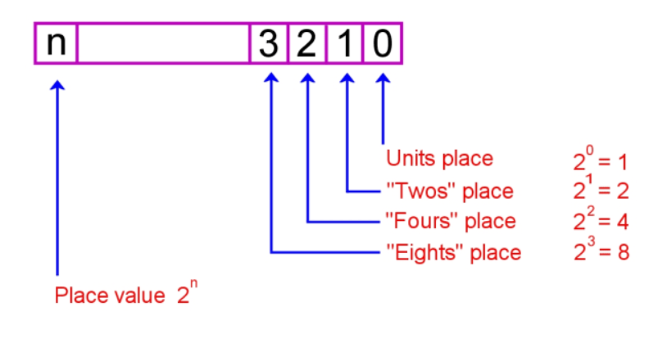
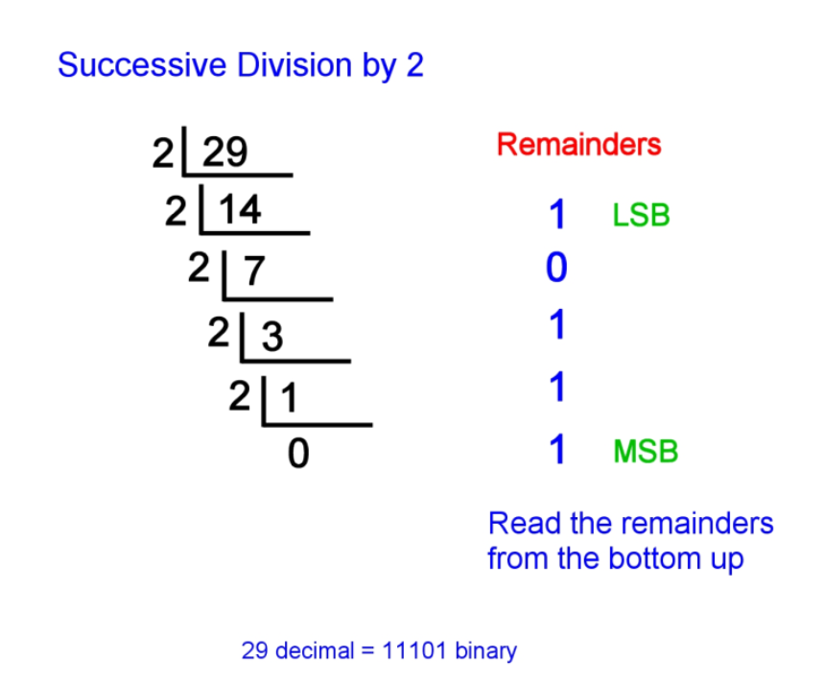
Decimal to Binary Conversion

Slide 8
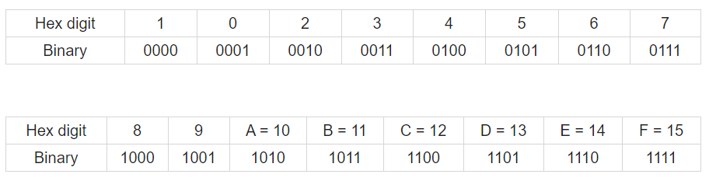
Hexadecimal Number System

Slide 9
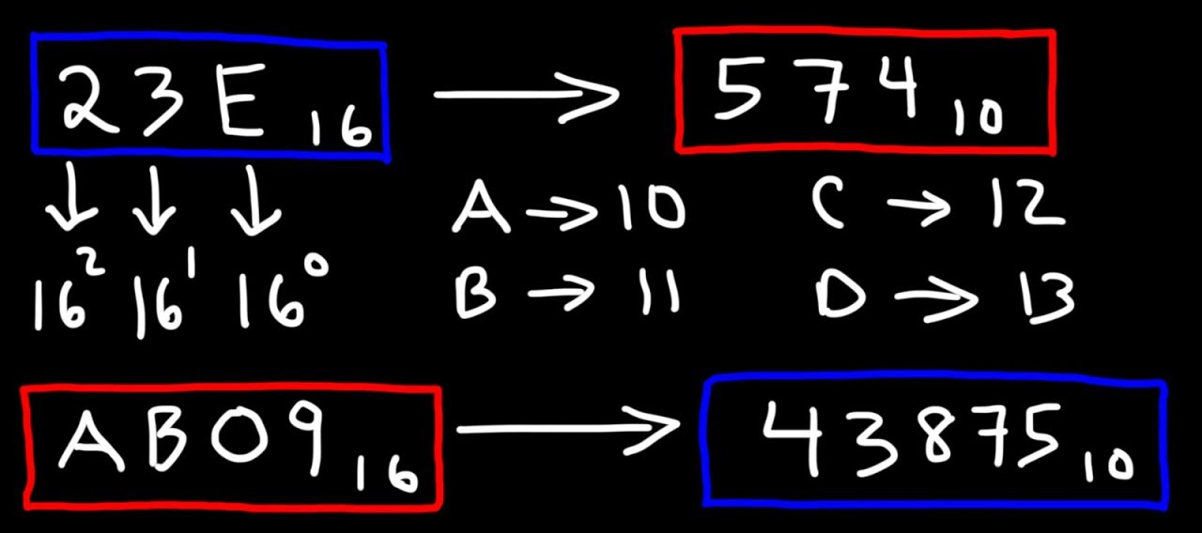
Hexadecimal Number System

Slide 10
Review of Network Architectures

Slide 11
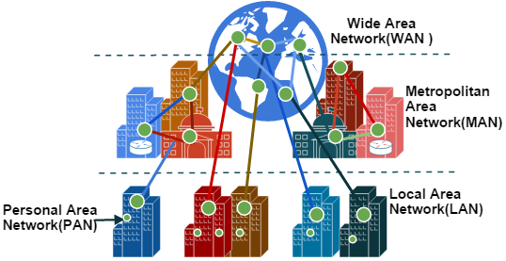
Types of Network

Slide 12
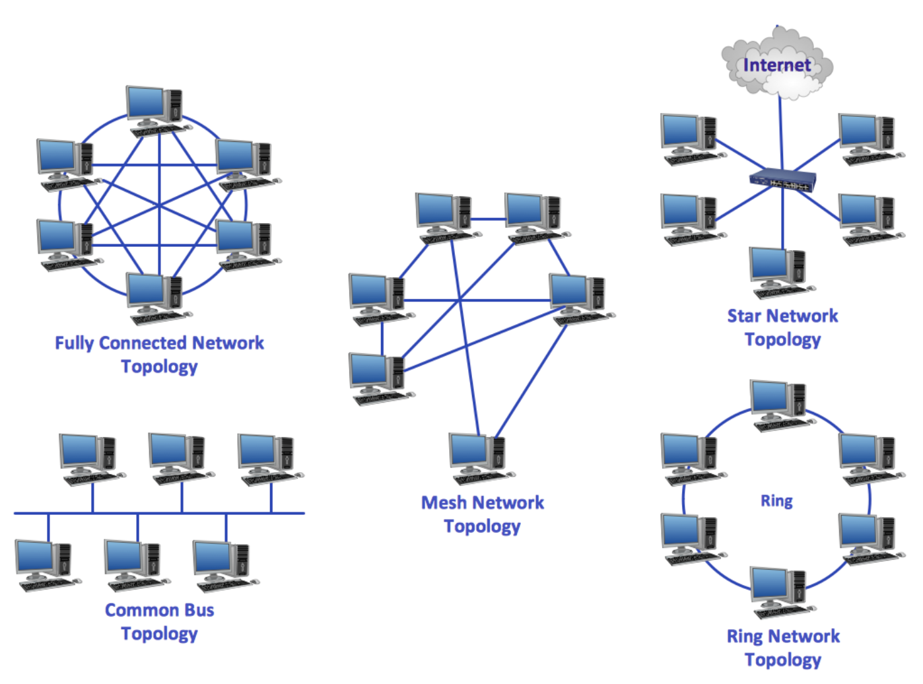
Network Topologies

Slide 13
OSI & TCP/ Reference Model

Slide 14
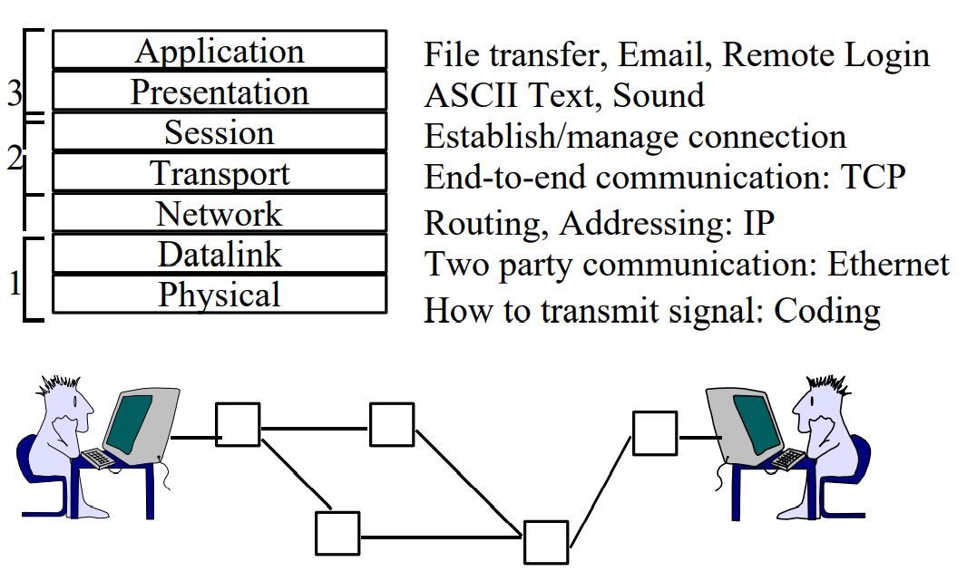
ISO/OSI Model
OSI or Open System Interconnection model was developed by International Standards Organization (ISO).
It gives a layered networking framework that conceptualizes how communications should be done between heterogeneous systems.
The focus was to provide interoperability between providers (temporal context -> computer, networks and appliance were provided by the same company).

Slide 15
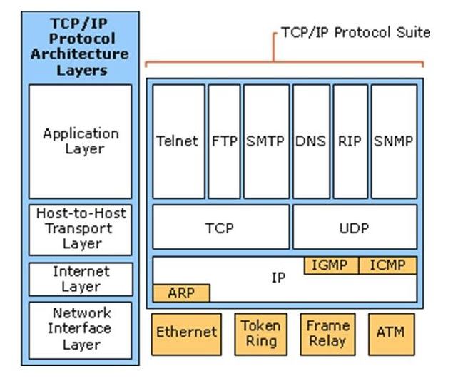
TCP/IP Architecture

Slide 16


Slide 17
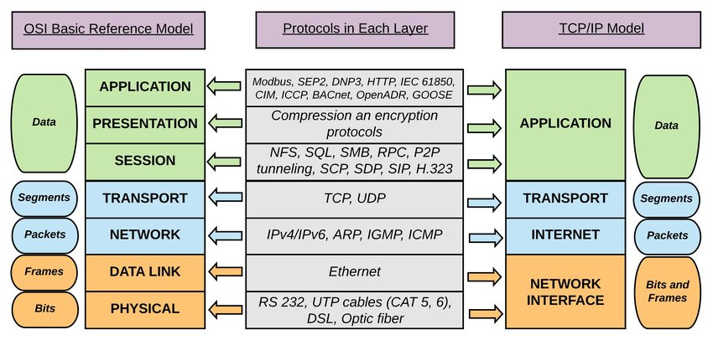
TCP/IP x ISO/OSI Model

Slide 18
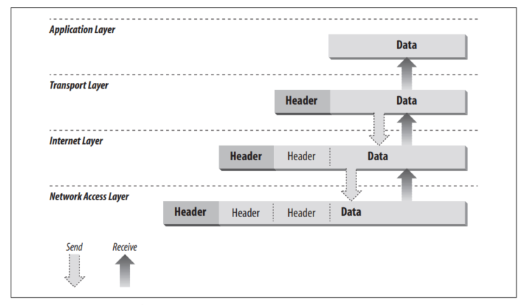
TCP/IP Architecture
Data Encapsulation
Hunt, C. (2002). TCP/IP network administration (Vol. 2). " O'Reilly Media, Inc.".

Slide 19
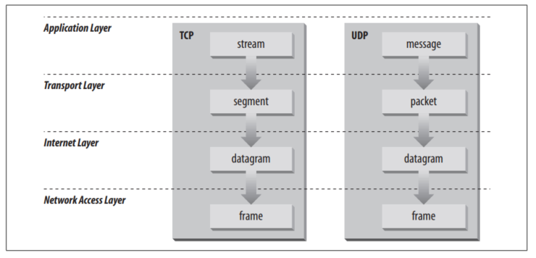
TCP/IP Architecture
Data Structure
Hunt, C. (2002). TCP/IP network administration (Vol. 2). " O'Reilly Media, Inc.".

Slide 20
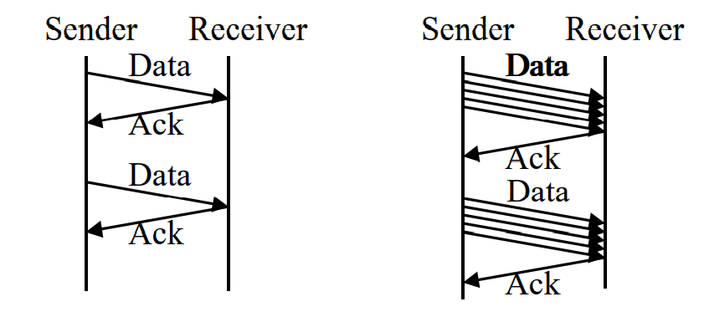
Flow Control
Flow Control = Sender does not flood the receiver, but maximizes throughput
Sender throttled until receiver grants permission
Methods: Stop and wait, Sliding window

Slide 21
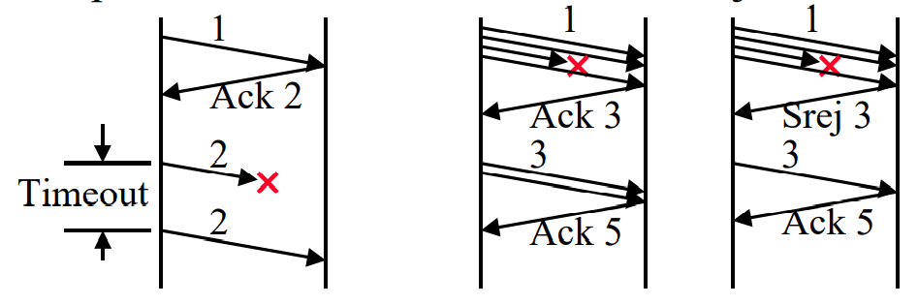
Error Control
Error Control: Deliver frames without error, in the proper order to network layer
Error Detection: Cyclic Redundancy Check, Sequence Numbers, Ack/Nak, Time-out
Error Recovery: Automatic Repeat Request (ARQ) Stop and Wait, Go back n Selective Reject

Slide 22
Connection-Oriented vs Connectionless
Connection-Oriented: Telephone System
Path setup before data is sent
Data need not have address. Circuit number is sufficient.
Connectionless: Postal System.
Complete address on each packet
The address decides the next hop at each router

Slide 23
Network Medium Access
Collisions: some networks has a shared medium, so there are rules for sending packets of data to avoid conflicts and to protect data integrity. Nodes determine when the network is available for sending packets. It is possible that two or more nodes at different locations will attempt to send data at the same time. When this happens, a packet collision occurs.
Minimizing collisions is a crucial element in the design and operation of networks.
Increased collisions are often the result of too many users on the network. This leads to competition for network bandwidth and can slow the performance of the network from the user’s point of view.
Segmenting the network is one way of reducing an overcrowded network, i.e., by dividing it into different pieces logically joined together with a bridge or switch.

Slide 24


Slide 25
Network Interface Layer

Slide 26
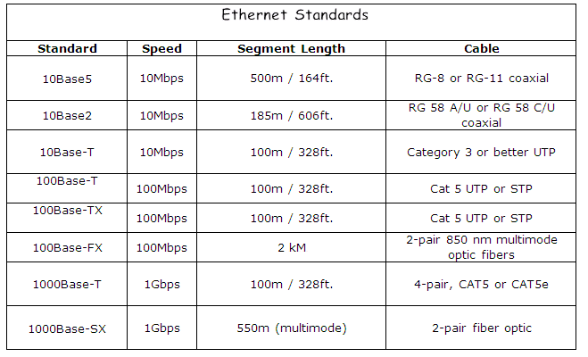
Ethernet Standard
Use the CSMA/CD

Slide 27
IP Protocol

Slide 28
Network Layer

Slide 29
IEEE 802 Standards
IEEE 802 is a family of standards for LANs, which defines an LLC and several MAC sublayers

Slide 30
IEEE 802.2/802.3

Slide 31
Internet Layer

Slide 32
Internet Protocol (IP)
The Internet Protocol is the heart of TCP/IP.
IP provides the basic packet delivery service on which TCP/IP networks are built.
Main Functions:
Defining the datagram, which is the basic unit of transmission on the Internet
Defining the Internet addressing scheme
Moving data between the Network Access Layer and the Transport Layer
Routing datagrams to remote hosts
Performing fragmentation and re-assembly of datagrams

Slide 33
IP Addressing
IPv4: 32-bit addresses
Usually written in dotted notation, e.g. 192.168.21.76
Each number is a byte
0
8
16
24
31
Decimal
192
168
21
76
Hex
C0
A8
15
4C
Binary
11000000
10101000
00010101
01001100
Based on slides from D. Choffnes Northeastern U. Revised Fall 2014 by P. Gill

Slide 34
IP Addressing and Forwarding
Routing Table Requirements
For every possible IP, give the next hop
But for 32-bit addresses, 2³² possibilities!
Too slow: 48GE ports and 4x10GE needs 176Gbps bandwidth DRAM: ~1-6 Gbps; TCAM is fast, but 400x cost of DRAM
Hierarchical address scheme
Separate the address into a network and a host
0
31
Pfx
Network
Host
Known by all routers
Known by edge (LAN) routers
Based on slides from D. Choffnes Northeastern U. Revised Fall 2014 by P. Gill

Slide 35
Classes of IP Addresses
0
1
8
16
24
31
Class A
0
Ntwk
Host
Example: MIT
18.*.*.*
1-126
0
2
8
16
24
31
Class B
10
Network
Host
Example: NEU
129.10.*.*
128-191
0
3
8
16
24
31
Class C
110
Network
Host
Example:
216.63.78.*
Based on slides from D. Choffnes Northeastern U. Revised Fall 2014 by P. Gill
192-223

Slide 36
Subnets
Problem: need to break up large A and B classes
Solution: add another layer to the hierarchy
From the outside, appears to be a single network
Only 1 entry in routing tables
Internally, manage multiple subnetworks
Split the address range using a subnet mask
Pfx
Ntwk
Subnet
Host
Subnet Mask:
11111111 11111111 11000000 00000000
Based on slides from D. Choffnes Northeastern U. Revised Fall 2014 by P. Gill

Slide 37


N-Level Subnet Hierarchy
Pfx
Network
Subnet
Host
…
Tree does not have a fixed depth
Increasingly specific subnet masks
…
Subtree size determined by length of subnet mask
…

Slide 38
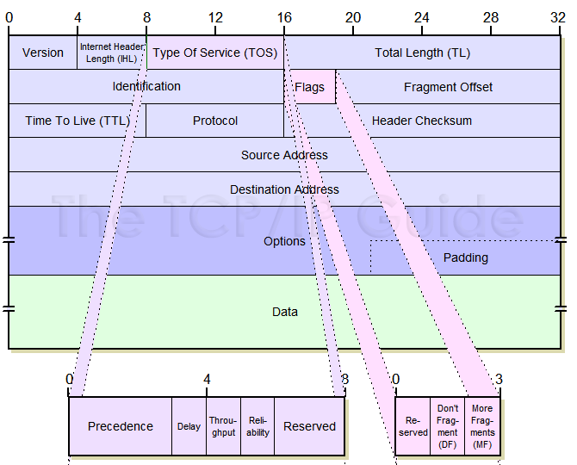
Internet Protocol (IP)
Internet Header Length (IHL): Specifies the length of the IP header, in 32-bit words. This includes the length of any options fields and padding. The normal value of this field when no options are used is 5 (5 32-bit words = 5*4 = 20 bytes).
Type Of Service (TOS): A field designed to carry information to provide quality of service features (unused).
Total Length (TL): Length of header + data.
Limits packets to 65,535 bytes

Slide 39
Internet Protocol (IP)
Identification: This field contains a 16-bit value that is a unique number for the original datagram.

Slide 40
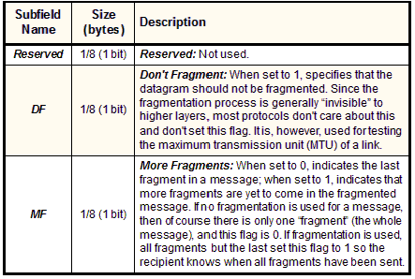
Internet Protocol (IP)
Flags:

Slide 41
Internet Protocol (IP)
Fragment Offset: When fragmentation of a message occurs, this field specifies the offset, or position, in the overall message where the data in this fragment goes.
It is specified in units of 8 bytes (64 bits). The first fragment has an offset of 0.

Slide 42
Internet Protocol (IP)
Time To Live (TTL): Specifies how long the datagram is allowed to “live” on the network, in terms of router hops.
Each router decrements the value of the TTL field (reduces it by one) prior to transmitting it.
If the TTL field drops to zero, the datagram is assumed to have taken too long a route and is discarded.
Used to implement trace route

Slide 43
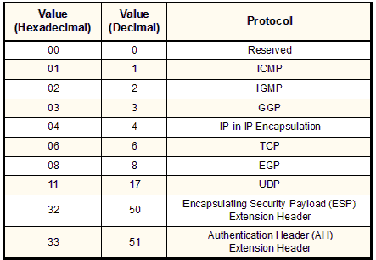
Internet Protocol (IP)
Protocol:

Slide 44
Internet Protocol (IP)
Header Checksum
Source and Destination Address
Options: One or more of several types of options may be included after the standard headers in certain IP datagrams.
Padding: If one or more options are included, and the number of bits used for them is not a multiple of 32, enough zero bits are added to “pad out” the header to a multiple of 32 bits (4 bytes).

Slide 45
Problem: Fragmentation
MTU = 4000
MTU = 2000
MTU = 1500
Datagram
Dgram1
Dgram2
1
2
3
4
Problem: each network has its own MTU
DARPA principles: networks allowed to be heterogeneous
Minimum MTU may not be known for a given path
IP Solution: fragmentation
Split datagrams into pieces when MTU is reduced
Reassemble original datagram at the receiver

Slide 46
Fragmentation Example
MTU = 4000
MTU = 2000
MTU = 1500
Length = 2000, M = 1
Offset = 0
IP
Data
Length = 3820, M = 0
20
1980
IP Hdr
Data
3800
1980
+ 1820
= 3800
20
Length = 1840, M = 0
Offset = 1980
IP
Data
20
1820

Slide 47
Fragmentation Example
MTU = 2000
MTU = 1500
Length = 2000, M = 1
Offset = 0
Length = 1500, M = 1
Offset = 0
IP
Data
IP
Data
Length = 1500, M = 1
Offset = 1980
20
1980
20
1480
IP
Data
Length = 520, M = 1
Offset = 1480
1480
+ 500
= 1980
20
1480
Length = 1840, M = 0
Offset = 1980
IP
Data
Length = 360, M = 0
Offset = 3460
IP
Data
20
500
IP
Data
20
1820
20
340

Slide 48
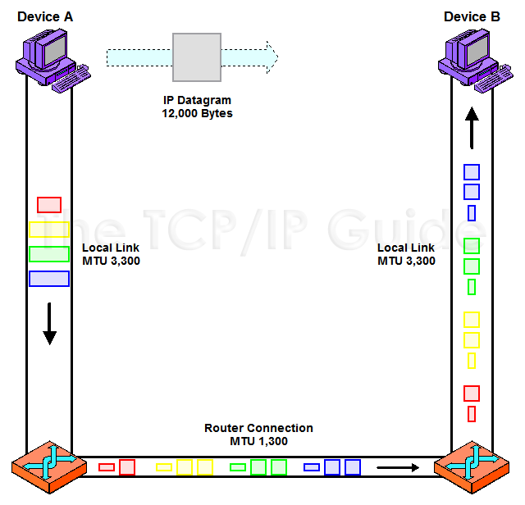
IP Message Reassembly Process
When a datagram is fragmented, either by the originating device or by one or more routers transmitting the datagram, it becomes multiple fragment datagrams.
The destination of the overall message must collect these fragments and then reassemble them into the original message.
Reassembly is accomplished by using the special information in the fields we saw in the preceding topic to help us “put the jigsaw puzzle back together again”.

Slide 49
IP Fragment Reassembly
Length = 1500, M = 1, Offset = 0
Performed at destination
M = 0 fragment gives us total data size
360 – 20 + 3460 = 3800
Challenges:
Out-of-order fragments
Duplicate fragments
Missing fragments
Basically, memory management nightmare
IP
Data
20
1480
Length = 520, M = 1, Offset = 1480
IP
Data
20
500
Length = 1500, M = 1, Offset = 1980
IP
Data
20
1480
Length = 360, M = 0, Offset = 3460
IP
Data
20
340

Slide 50
Fragmentation in Reality
Fragmentation is expensive
Memory and CPU overhead for datagram reconstruction
Want to avoid fragmentation if possible
MTU discovery protocol
Send a packet with “don’t fragment” bit set
Keep decreasing message length until one arrives
May get “can’t fragment” error from a router, which will explicitly state the supported MTU
Router handling of fragments
Fast, specialized hardware handles the common case
Dedicated, general purpose CPU just for handling fragments

Slide 51
IP Addressing
IPv4: 32-bit addresses
Usually written in dotted notation, e.g. 192.168.21.76
Each number is a byte
0
8
16
24
31
Decimal
192
168
21
76
Hex
C0
A8
15
4C
Binary
11000000
10101000
00010101
01001100
Based on slides from D. Choffnes Northeastern U. Revised Fall 2014 by P. Gill

Slide 52
IP Addressing and Forwarding
Routing Table Requirements
For every possible IP, give the next hop
But for 32-bit addresses, 2³² possibilities!
Too slow: 48GE ports and 4x10GE needs 176Gbps bandwidth DRAM: ~1-6 Gbps; TCAM is fast, but 400x cost of DRAM
Hierarchical address scheme
Separate the address into a network and a host
0
31
Pfx
Network
Host
Known by all routers
Known by edge (LAN) routers
Based on slides from D. Choffnes Northeastern U. Revised Fall 2014 by P. Gill

Slide 53
Classes of IP Addresses
0
1
8
16
24
31
Class A
0
Ntwk
Host
Example: MIT
18.*.*.*
1-126
0
2
8
16
24
31
Class B
10
Network
Host
Example: NEU
129.10.*.*
128-191
0
3
8
16
24
31
Class C
110
Network
Host
Example:
216.63.78.*
Based on slides from D. Choffnes Northeastern U. Revised Fall 2014 by P. Gill
192-223

Slide 54
Subnets
Problem: need to break up large A and B classes
Solution: add another layer to the hierarchy
From the outside, appears to be a single network
Only 1 entry in routing tables
Internally, manage multiple subnetworks
Split the address range using a subnet mask
Pfx
Ntwk
Subnet
Host
Subnet Mask:
11111111 11111111 11000000 00000000
Based on slides from D. Choffnes Northeastern U. Revised Fall 2014 by P. Gill

Slide 55
N-Level Subnet Hierarchy
Pfx
Network
Subnet
Host
…
Tree does not have a fixed depth
Increasingly specific subnet masks
…
Subtree size determined by length of subnet mask
…

Slide 56
Internet Layer

Slide 57
Address Resolution Protocol (ARP)

Slide 58
(Reverse) Address Resolution Protocol (RARP/ARP)
The ARP and RARP protocols perform the translation between IP addresses and MAC layer addresses
The Internet is based on IP addresses
Data link protocols (Ethernet, FDDI, ATM) may have different (MAC) addresses

Slide 59
How an address is translated?

Slide 60
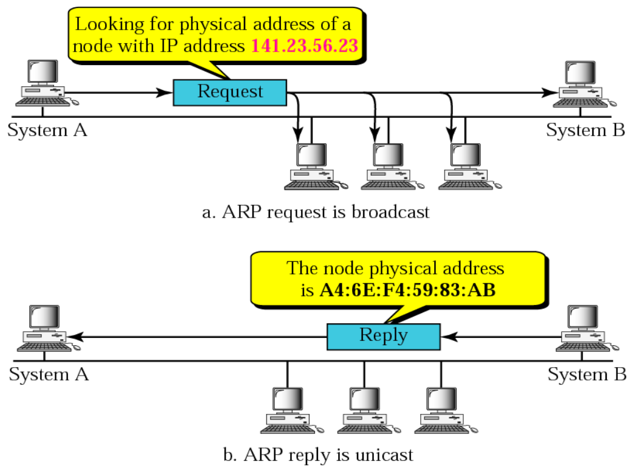
How does ARP work?

Slide 61
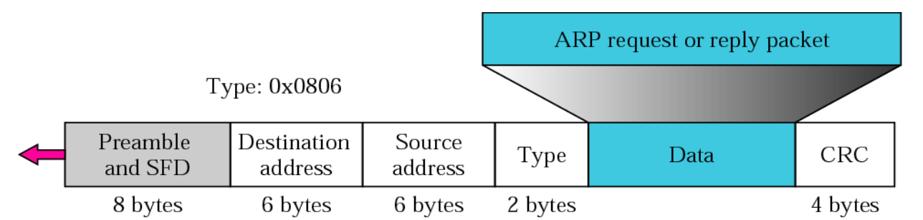
ARP Package

Slide 62
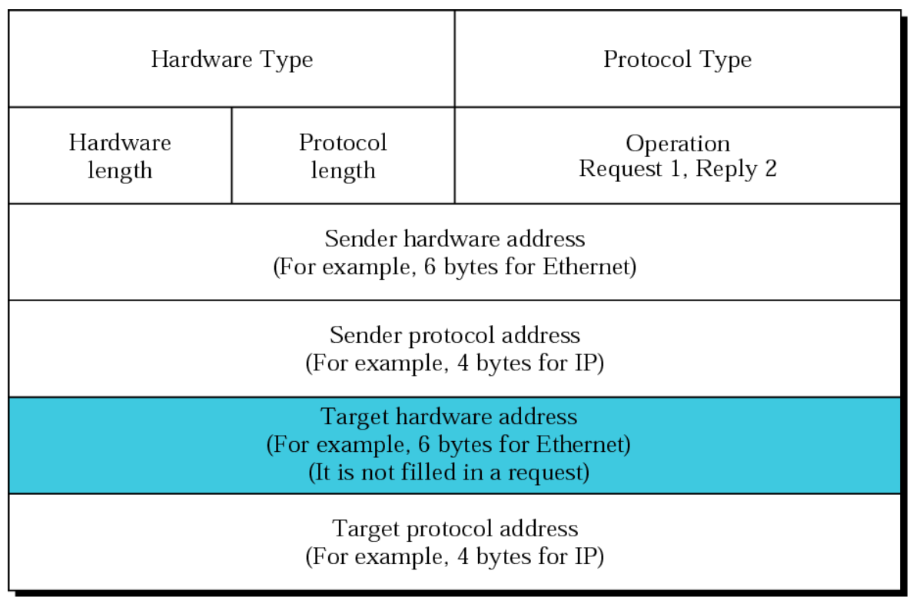
ARP Package

Slide 63
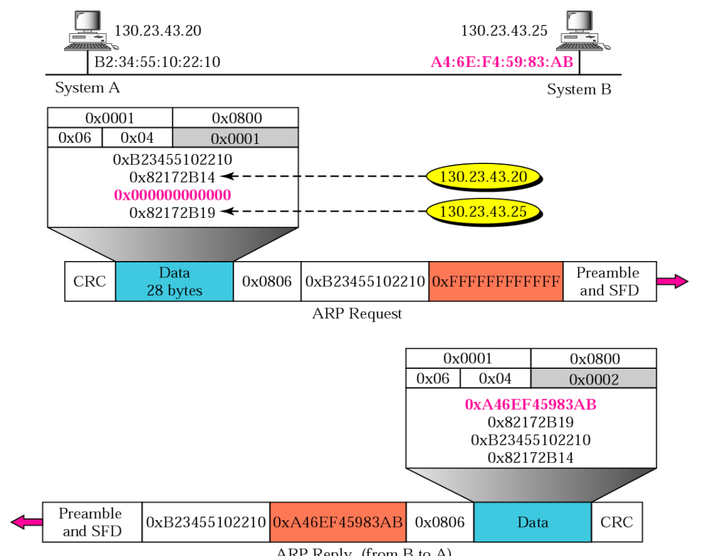
ARP Example
PS: CRC, Preamble and SFD are part of the Ethernet frame.

Slide 64
Internet Layer

Slide 65
Internet Control Message Protocol (ICMP)
The Internet Control Message Protocol (ICMP) is a helper protocol that supports IP with facility for
Error reporting
Simple queries
ICMP messages are encapsulated as IP datagrams:

Slide 66
ICMP message format
4 byte header:
Type (1 byte): type of ICMP message
Code (1 byte): subtype of ICMP message
Checksum (2 bytes): like IP header checksum. Checksum is calculated over entire ICMP message
If there is no additional data, there are 4 bytes set to zero. → each ICMP messages is at least 8 bytes long

Slide 67
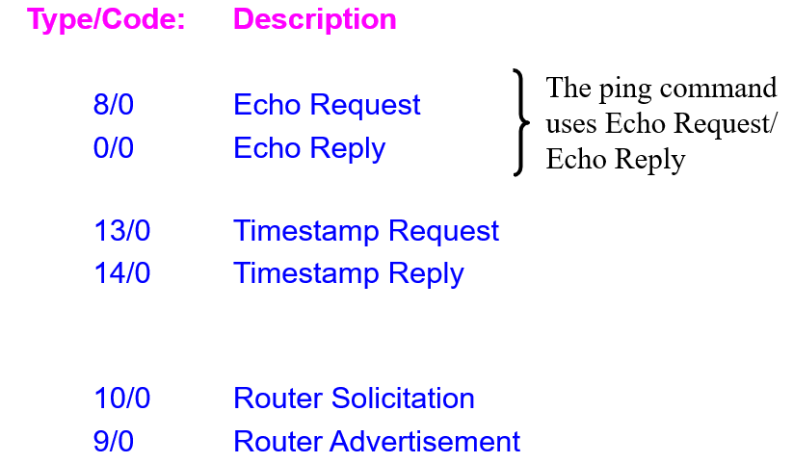
ICMP Query message
ICMP query:
Request sent by host to a router or host
Reply sent back to querying host

Slide 68
ICMP Error message
ICMP error messages report error conditions
Typically sent when a datagram is discarded
Error message is often passed from ICMP to the application program

Slide 69
Transport Layer

Slide 70
Internet Transport Protocol
Provide logical communication between application processes running on different hosts
Run on end hosts
Sender: breaks application messages into segments, and passes to network layer
Receiver: reassembles segments into messages, passes to application layer
Multiple transport protocol available to applications
Internet: TCP and UDP
application
transport
network
data link
physical
network
data link
physical
network
data link
physical
network
data link
physical
logical end-end transport
network
data link
physical
network
data link
physical
application
transport
network
data link
physical

Slide 71
Unreliable Message Delivery Service
Lightweight communication between processes
Avoid overhead and delays of ordered, reliable delivery
Send messages to and receive them from a socket
User Datagram Protocol (UDP)
IP plus port numbers to support (de)multiplexing
Optional error checking on the packet contents
SRC port
DST port
checksum
length
DATA

Slide 72
Transmission Control Protocol (TCP)
Connection oriented
Explicit set-up and tear-down of TCP session
Stream-of-bytes service
Sends and receives a stream of bytes, not messages
Reliable, in-order delivery
Checksums to detect corrupted data
Acknowledgments & retransmissions for reliable delivery
Sequence numbers to detect losses and reorder data
Flow control
Prevent overflow of the receiver’s buffer space
Congestion control
Adapt to network congestion for the greater good

Slide 73
TCP is a “Stream of Bytes” Service
Host A
Byte 0
Byte 1
Byte 2
Byte 3
Byte 80
Segment sent when:
Segment full (Max Segment Size),
Not full, but times out, or
“Pushed” by application.
TCP Data
TCP Data
Host B
Byte 0
Byte 1
Byte 2
Byte 3
Byte 80

Slide 74
Why do I need to broke a package into segments?
IP Data
TCP Data (segment)
TCP Hdr
IP Hdr
IP packet
No bigger than Maximum Transmission Unit (MTU)
E.g., up to 1500 bytes on an Ethernet
TCP packet
IP packet with a TCP header and data inside
TCP header is typically 20 bytes long
TCP segment
No more than Maximum Segment Size (MSS) bytes
E.g., up to 1460 consecutive bytes from the stream

Slide 75
Sequence Numbers
Host A
ISN (initial sequence number)
Sequence number = 1st byte
TCP
HDR
TCP Data
ACK sequence number = next expected byte
TCP Data
TCP
HDR
Host B
Why the ISN number cannot be zero?

Slide 76
TCP Three-Way Handshake
A
B
Three-way handshake to establish connection
Host A sends a SYN (open) to the host B
Host B returns a SYN acknowledgment (SYN ACK)
Host A sends an ACK to acknowledge the SYN ACK
SYN
SYN ACK
Each host tells its ISN to the other host.
ACK
Data
Data

Slide 77
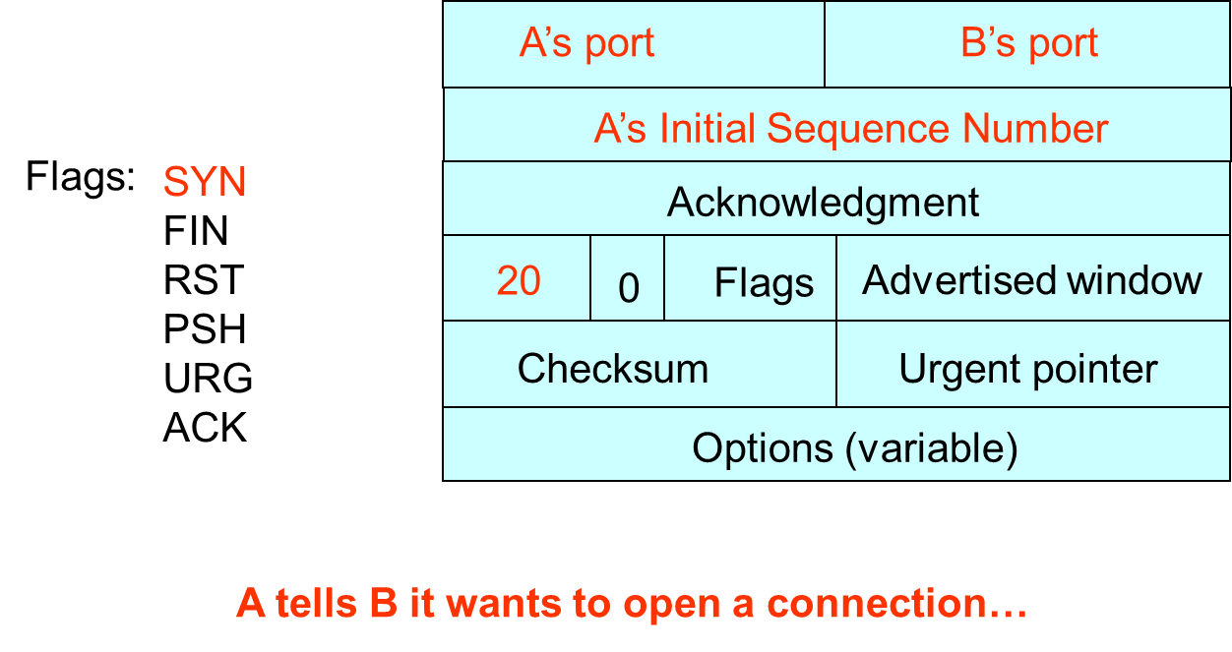
TCP Three-Way Handshake
A
B
SYN=1, seq=A

Slide 78
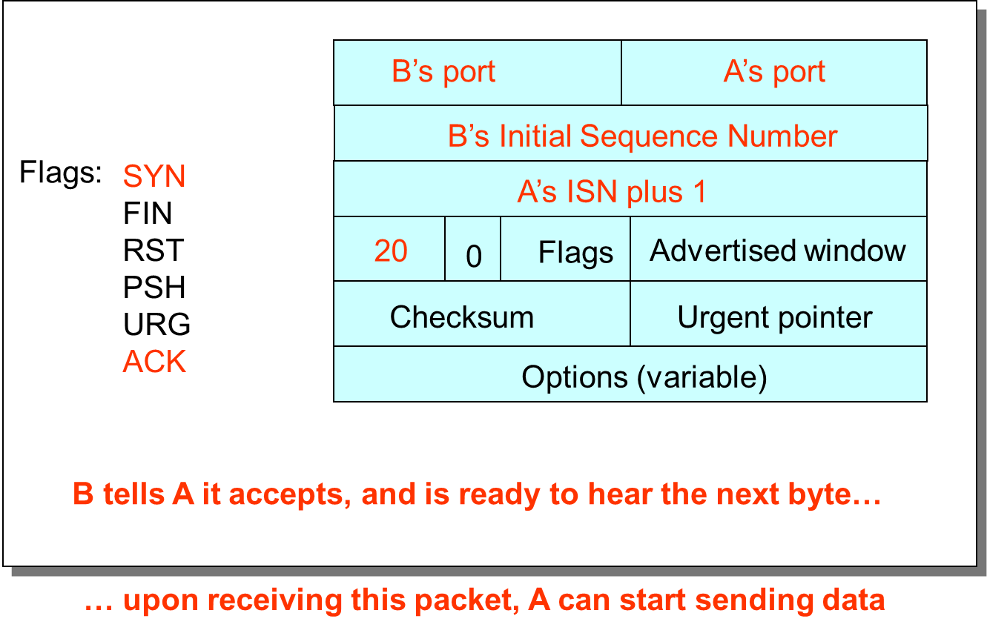
TCP Three-Way Handshake
A
B
SYN=1, seq=A
SYN=1 , seq=B, ACK=A+1

Slide 79
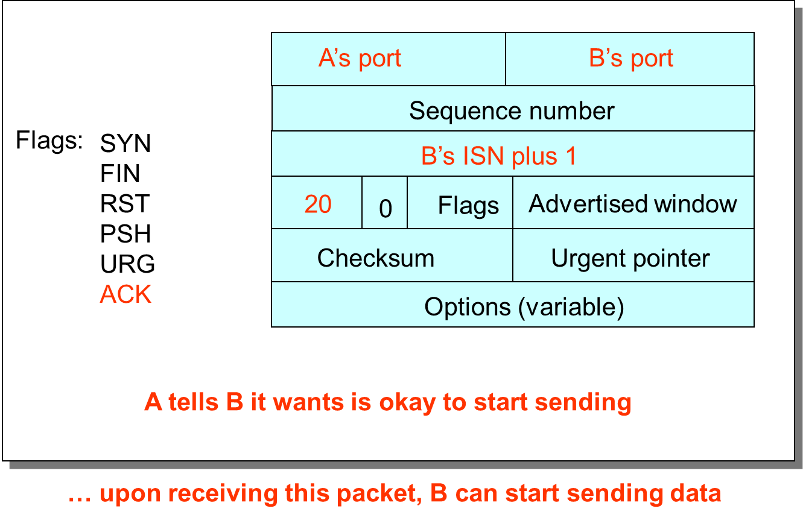
TCP Three-Way Handshake
A
B
SYN=1, seq=A
SYN=1 , seq=B, ACK=A+1
seq=A+1, ACK=B+1

Slide 80
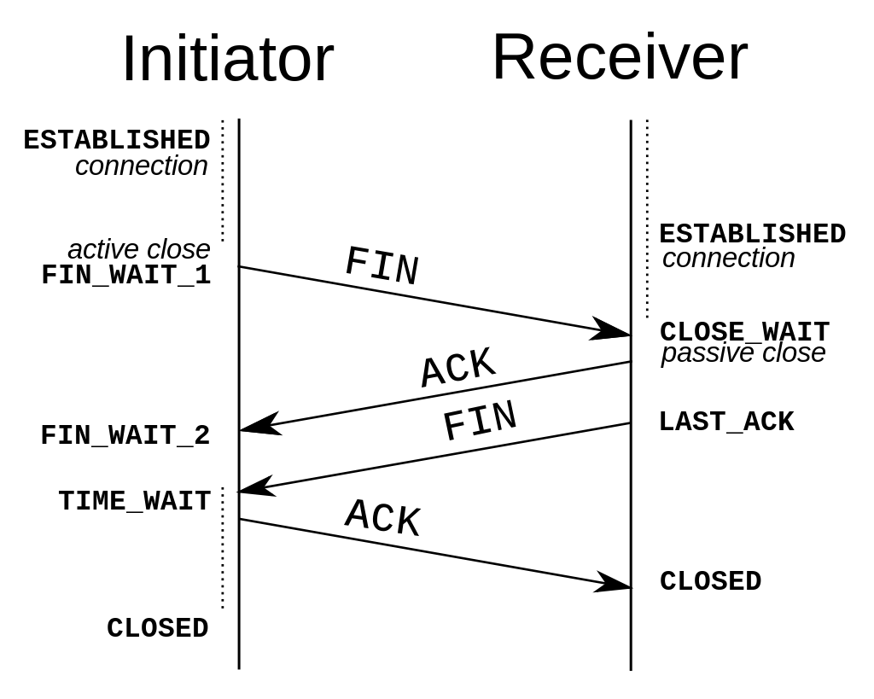
Connection Termination

Slide 81
TCP Retransmission (ARQ)
Automatic Repeat reQuest (ARQ)
Automatic Repeat Request
Receiver sends acknowledgment (ACK) when it receives packet
Sender waits for ACK and timeouts if it does not arrive within some time period
Simplest ARQ protocol
Stop and wait
Send a packet, stop and wait until ACK arrives
Sender
Receiver
Packet
Timeout
ACK
Time

Slide 82
Reasons for Retransmission
Packet
Packet
Packet
Timeout
Timeout
ACK
Timeout
ACK
Packet
Packet
Packet
ACK
Timeout
Timeout
Timeout
ACK
ACK
Packet lost
ACK lost
DUPLICATE PACKET
Early timeout
DUPLICATE PACKETS

Slide 83
Why does require TCP Sliding Window?
Stop-and-wait is inefficient
Only one TCP segment is “in flight” at a time
Especially bad when delay-bandwidth product is high
Numerical example
1.5 Mbps link with a 45 msec round-trip time (RTT)
Delay-bandwidth product is 67.5 Kbits (or 8 KBytes)
But, sender can send at most one packet per RTT
Assuming a segment size of 1 KB (8 Kbits)
… leads to 8 Kbits/segment / 45 msec/segment ➔ 182 Kbps
That’s just one-eighth of the 1.5 Mbps link capacity

Slide 84
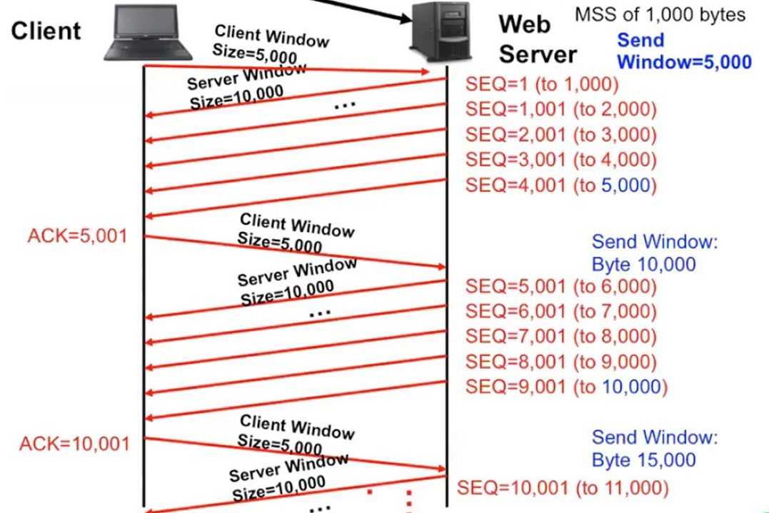
Sliding Window
Window size
Amount that can be sent without acknowledgment
Receiver needs to be able to store this amount of data
Receiver advertises the window to the receiver
Tells the receiver the amount of free space left
… and the sender agrees not to exceed this amount
Client windows < server window
Segment = 1000 bytes

Slide 85
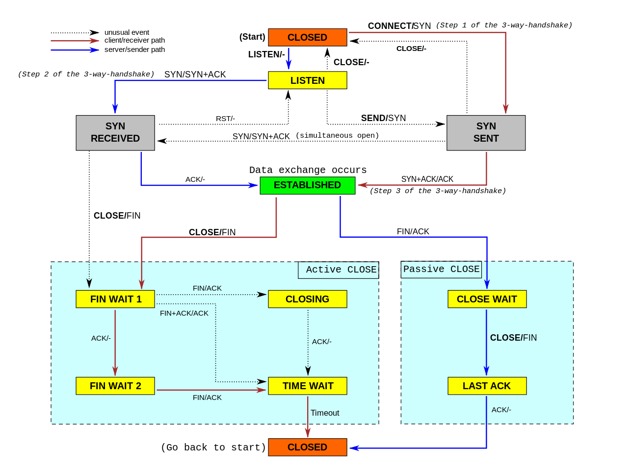
TCP State-Machine

Slide 86
Computational Intelligence (TC2027)

